Slide 1
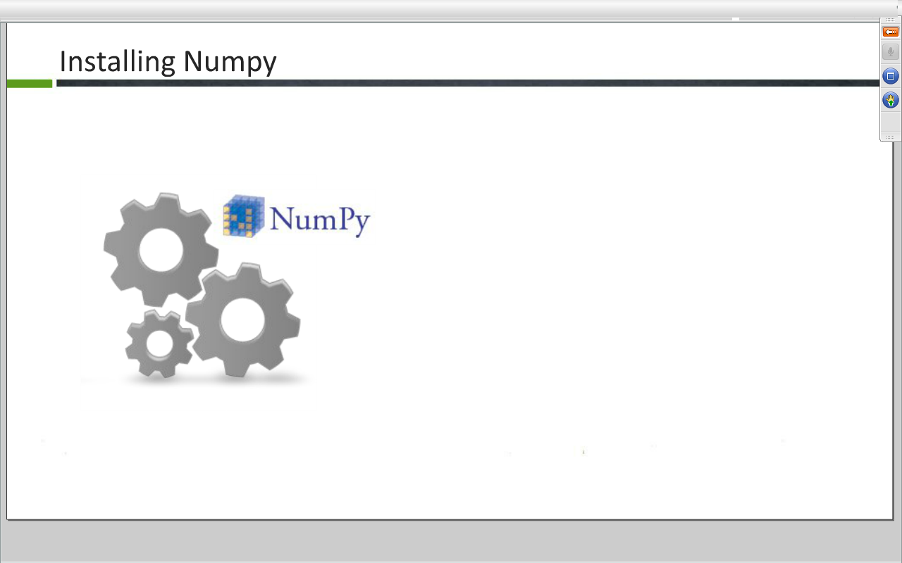

Slide 2
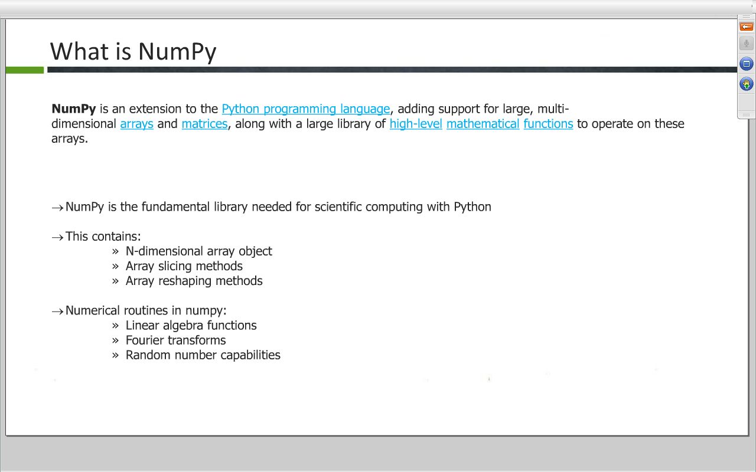

Slide 3
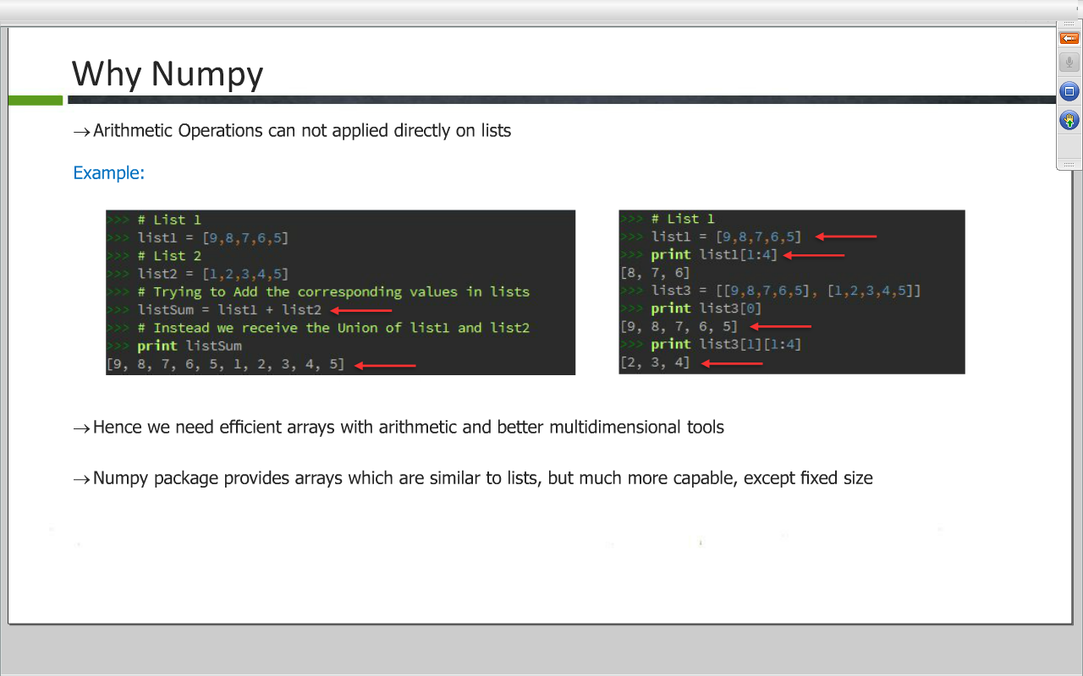

Slide 4
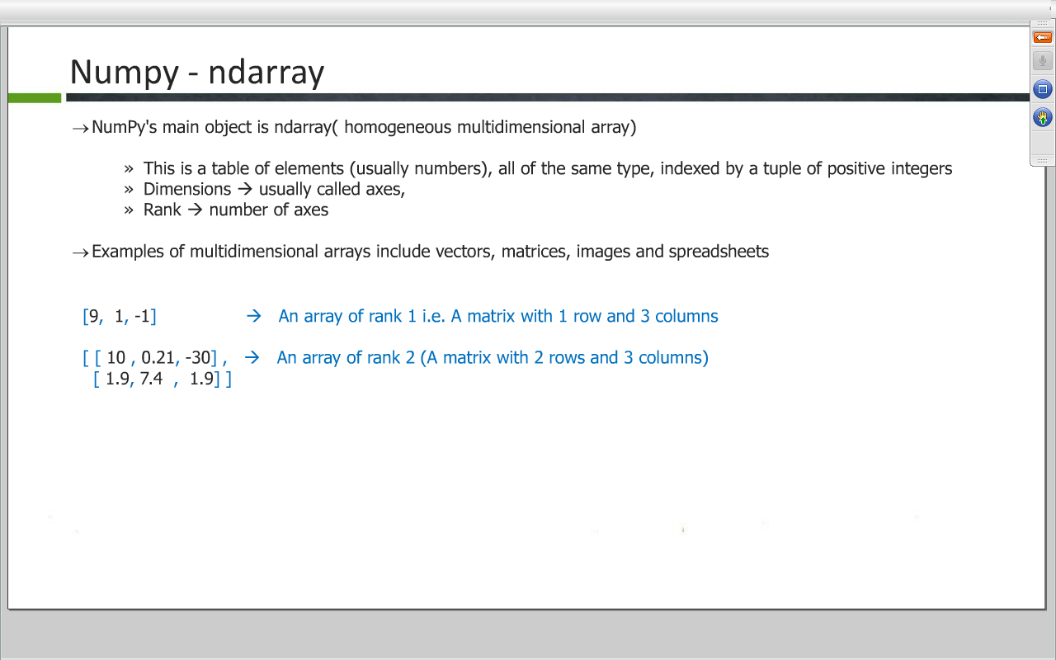

Slide 5
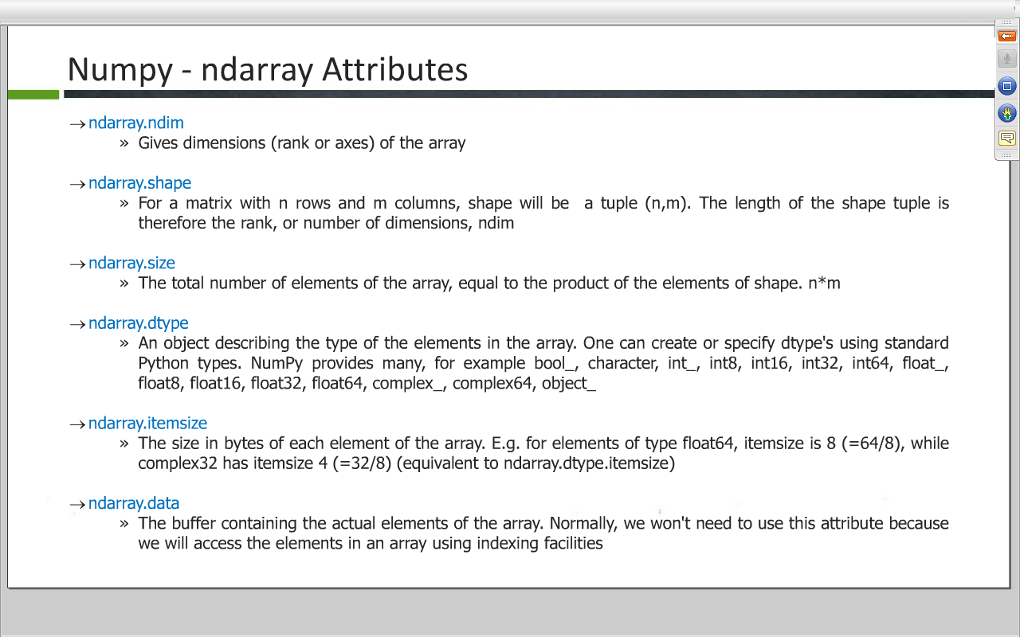

Slide 6
Numpy - Array Creation and Basic Operation
>> import numpy as np
>> #Creating a list
>> list=[[1,2,3],[5,10,15],[10,20,30]]
>> #Creating an array using numpy
>> arr=np.array(list)
>> arr
array([[ 1, 2, 3],
[ 5, 10, 15],
[10, 20, 30]])

Slide 7
Contd…
>> #Dimensions of the array
>> arr.shape
(3, 3)
>> # Type of the array
>> arr.dtype
dtype('int32')
>> #Fetaching value from array using index
>> arr[0]
array([1, 2, 3])

Slide 8
Contd…
> #Fetching value from array using index
>> arr[0,1]
2
>> #Fetching second column values
>>> arr[:, 1]
array([ 2, 10, 20])

Slide 9
Numpy Basic Use ||
>>arr
array([[ 1, 2, 3],
[ 5, 10, 15],
[10, 20, 30]])
>>> #Fetching value at position (1,3) in the array
>>> arr[1,2]
15
#updating the value of a column
>>> arr[:, 0]=[9,9,9]
>>> arr
array([[ 9, 2, 3],
[ 9, 10, 15],
[ 9, 20, 30]])

Slide 10
Numpy Basic Use ||
>> #Generating an array of zeroes
>> arr=np.zeros(6)
>> arr
array([ 0., 0., 0., 0., 0., 0.])
>> arr.dtype
dtype('float64')
>> #Generating an array of integers with values as o
>> arr=np.zeros(3,dtype=np.int)
>> arr
array([0, 0, 0])

Slide 11
Numpy Basic Use ||
#Generating an array of integer with value as 1
arr=np.ones(5)
>> arr
array([ 1., 1., 1., 1., 1.])
>> #Generating an array of range (5)
>> arr=np.arange(5)
>> arr
array([0, 1, 2, 3, 4])

Slide 12
Numpy Basic Use ||
#Operation on array will create a new array, with new type
>> arr*2.0
array([ 0., 2., 4., 6., 8.])
#Generating an array of range(5) with float value
>>> arr=np.arange(5,dtype=np.float)
>>> arr
array([ 0., 1., 2., 3., 4.])
#Generating an array of range(start,stop,step)
>>> arr=np.arange(0,10,2)
>>> arr
array([0, 2, 4, 6, 8])

Slide 13
Numpy Copy and View
Two ndarrays may be views to the same memory
arr1=np.array([1,5,9,2])
>> #Assigning value of arr1 to arr2
>> arr2=arr1
>> arr2
array([1, 5, 9, 2])

Slide 14
Numpy Copy and View
Deep Copy vs Shallow Copy(View)
>>arr1=np.array([1,5,9,2])
>> arr2=arr1.copy()
>> #Checking if they are equal
>> arr1 is arr2
False
>> arr2
array([1, 5, 9, 2])

Slide 15
Numpy Copy and View
#Shallow Copy
>> arr1=np.array([1,5,9,2])
>> arr2=arr1.view()
>> #Checking if they are equal or not
>> arr1 is arr2
False
>> arr2.base is arr1
True

Slide 16
Numpy Basic Use IV
>> arr1=np.array([5,5,5,5])
>> arr2=np.array([5,5,5,5])
>> #Diving an array by an array
>> arr1/arr2
array([1, 1, 1, 1])
>> #Using integer lists as indices in an array
>> arr=np.arange(20)
>> indices=[1,5,6,14]
>> #Fetching values for the indices present in the list
>> arr[indices]
array([ 1, 5, 6, 14])

Slide 17
Numpy Basic Use IV
arr=np.arange(5)
>> #Comparing the values of array
>> div =arr%2==0
>> div
array([ True, False, True, False, True], dtype=bool)
>> arr
array([0, 1, 2, 3, 4])
>>> div
array([ True, False, True, False, True], dtype=bool)
>>> arr[div]
array([0, 2, 4])

Slide 18
Numpy-Array Methods(Cont…)
>> arr.min()
0
>> arr.max()
4
>> arr.all()
False
>> arr.any()
True
>> arr.nonzero()
(array([1, 2, 3, 4]),)

Slide 19
Numpy-Array Mathematics
>>Array1
>> arr1=np.array([9,5,2], float)
>>Array2
>>> arr2=np.array([2,5,9], float)
>> arr1+arr2
array([ 11., 10., 11.])
>> arr1-arr2
array([ 7., 0., -7.])
>> arr1*arr2
array([ 18., 25., 18.])
>> arr1/arr2
array([ 4.5 , 1. , 0.22222222])

Slide 20
Numpy-Array Mathematics
>> arr1%arr2
array([ 1., 0., 2.])
>> arr2**arr1
array([ 512., 3125., 81.])
>> arr1=np.array([[1,2],[3,4],[5,6]], float)
>> arr1
array([[ 1., 2.],
[ 3., 4.],
[ 5., 6.]])
>> arr2=np.array([-1, 3], float)
>> arr2
array([-1., 3.])
>> arr1+arr2
array([[ 0., 5.],
[ 2., 7.],
[ 4., 9.]])

Slide 21
Numpy - Array Mathematics - Sorting
*arr=np.array([10,30,5.5,9.2,5.3,7])
>> arr.sort()
>> arr
array([ 5.3, 5.5, 7. , 9.2, 10. , 30. ])
>> arr=np.array([10,30,5.5,9.2,5.3,7])
>> np.sort(arr)
array([ 5.3, 5.5, 7. , 9.2, 10. , 30. ])
>> arr
array([ 10. , 30. , 5.5, 9.2, 5.3, 7. ])

Slide 22
Numpy - Array Mathematics - Sorting
>> # Calling argsort()
>> arr.argsort()
array([4, 2, 5, 3, 0, 1])
>> #Using argsort() indices to get sorted array
>> arr
array([ 10. , 30. , 5.5, 9.2, 5.3, 7. ])
>> arr[arr.argsort()]
array([ 5.3, 5.5, 7. , 9.2, 10. , 30. ])

Slide 23
Numpy - Array Functions
>> arr=np.array([[9,8],[7,6]])
>> arr
array([[9, 8],
[7, 6]])
>> #Calling Transpose()
>> arr.transpose()
array([[9, 7],
[8, 6]])

Slide 24
Numpy - Array Functions
>> #Creating 3X3 identity matrix
>> np.eye(3)
array([[ 1., 0., 0.],
[ 0., 1., 0.],
[ 0., 0., 1.]])
>> arr=np.array([[0.0,-1.0],[1.0,0.0]])
* Matrix Product
>> np.dot(arr,arr)
array([[-1., 0.],
[ 0., -1.]])

Slide 25
Numpy – Matrix Function
>> import numpy as np
>> m1=np.mat([[2,3],[4,5]])
>> m1
matrix([[2, 3],
[4, 5]])
>> m2=np.mat([[5,6,7],[2,3,4]])
>> m2
matrix([[5, 6, 7],
[2, 3, 4]])

Slide 26
Numpy – Matrix Function
>> m1*m2
matrix([[16, 21, 26],
[30, 39, 48]])
>> m1**2
matrix([[16, 21],
[28, 37]])
>> m2.T
matrix([[5, 2],
[6, 3],
[7, 4]])

